Slide 1
Lesson 3 – OOP

Slide 2
Lesson goals
Class design
Implement encapsulation
Implement inheritance including visibility modifiers and composition
Implement polymorphism

Slide 3
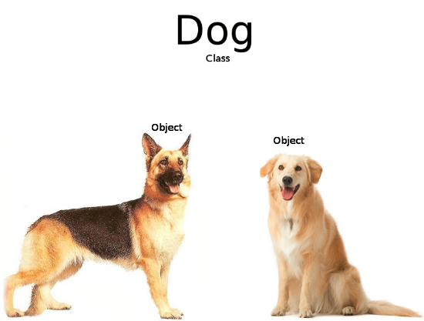
Object vs Class

Slide 4
Abstract Classes
May contain any number of methods including zero
If class has at least one abstract method – class is abstract
Abstract methods may not appear in a class that is not abstract
The first concrete subclass of an abstract class is required to implement all abstract methods that were not implemented by a superclass

Slide 5
Method vs Constructor
Method describes behavior
Method signature:
name
arguments (including order)
Specific method with the same to class name and without return statement called Constructor

Slide 6
Constructor
class Monkey extends Animal { int paws; public Monkey() { super(); // not necessary } Monkey(int paws) { super(“Leo");
paws = paws; // BAD this.paws = paws; } public void Monkey() { this(3); // not compile } public void Monkey(int i) { System.out.println(“in method"); }
}
class Animal { String name; Animal() { this("No-Name"); } public Animal(String name) { this.name = name; } }
class Main{ public static void main(String[] args) { println(new Monkey()); println(new Monkey(2)); } }

Slide 7
Overriding rules
The access modifier must be the same or more accessible;
The return type must be the same or a more restrictive type, also known as covariant return types;
If any checked exceptions are thrown, only the same exceptions or subclasses of those exceptions can be thrown;
The methods must not be static. (If they are, the method is hidden and not overridden);
@Override - It is a great idea to get in the habit of using it in order to avoid accidentally overloading a method.

Slide 8
Overloading precedence
Exact match by type
Matching a superclass type
Converting to a larger primitive type
Converting to an autoboxed type
Varargs

Slide 9
Overloading precedence
class Overloading { static void overloadedMethod(int i) { //will enter if nothing is commented System.out.println("in int"); }
static void overloadedMethod(long i) { //will enter if comment 'int' System.out.println("in long"); }
static void overloadedMethod(Integer i) { //will enter if comment 'int' and 'long' System.out.println("in Integer"); }
static void overloadedMethod(Number i) { //will enter if comment 'int’, 'long' and 'Integer' System.out.println("in Number"); }
static void overloadedMethod(int... i) { //will enter if comment 'int’, 'long’, 'Integer' andqqqq 'Number' System.out.println("in var arg"); }
public static void main(String[] args) { overloadedMethod(10); } }

Slide 10
Overloading vs Overriding
class Game { void play() { // move to the left } }
class Mario extends Game { @Override public void play() { // move to the left, move to the right } void play(Character character) { // do something }
int play() { // do something again } }

Slide 11
Interface
Defines a set of public abstract methods, which classes implementing the interface must provide.
Allows you to define what a class can do without saying how to do it (interface is a contract)
A class may implement multiple interfaces as well as extend class that implements interfaces, allowing for limited multiple inheritance in Java
May extend other interfaces, although they may not extend a class and vice versa
May contain public static final constant values, public, private and static methods, public default methods.

Slide 12
Interface
interface Walk { int SOME_CONST = 1; public static final int ANOTHER_CONST = 1; int legsCount();
private void doSomething() {
//do something
} abstract double getMaxSpeed(); }
interface Run extends Walk { public abstract boolean canHuntWhileRunning(); default double getMaxSpeed(){ return 1; }
static void doSomeStaticWork(){ //do something
} }
class Lion implements Run { public int legsCount() { return 4; } public boolean canHuntWhileRunning() { return true; } public double getMaxSpeed() { return 100; } }

Slide 13
Enumeration
A special data type that enables for a variable to be a set of predefined constants
Has unique set of values
Can implement interface
Can NOT extend class
Can contain fields and methods
Singleton

Slide 14
Enumeration
enum Planet implements IGravitable { MERCURY (3.303e+23, 2.4397e6) { @Override double surfaceGravity() { return -1; } }, VENUS (4.869e+24, 6.0518e6), EARTH (5.976e+24, 6.37814e6) // ... ; private final double mass; // in kilograms private final double radius; // in meters
Planet(double mass, double radius) { this.mass = mass; this.radius = radius; }
// universal gravitational constant (m3 kg-1 s-2) public static final double G = 6.67300E-11;
@Override double surfaceGravity() { return G * mass / (radius * radius); } }
static void main(String[] args) { double mass = Planet.EARTH.surfaceGravity();
for (Planet p : Planet.values()){ System.out.println("Your weight on “ + p + “ is “ +
p.surfaceWeight(mass)); } System.out.println("Is Earth inhabited: " +
isPlanetInhabited(Planet.EARTH)); } static boolean isPlanetInhabited(Planet alivePlanet) { switch (alivePlanet){ case EARTH: return true; case VENUS: case MERCURY: default: return false; } }

Slide 15
Design principle
A design principle is an established idea or best practice that facilitates the software design process.
More logical code
Code that is easier to understand
Classes that are easier to reuse in other relationships and applications
Code that is easier to maintain

Slide 16
OOP principles
Encapsulation
Abstraction
Inheritance
Polymorphism

Slide 17
OOP principles
Everything is object
Object is a class instance
Program – a set of interacting objects
Object has a state and behavior

Slide 18
OOP principles. Encapsulation
Encapsulation is the mechanism of hiding of data implementation by restricting access to public methods. Instance variables are kept private and accessor methods are made public to achieve this.

Slide 19
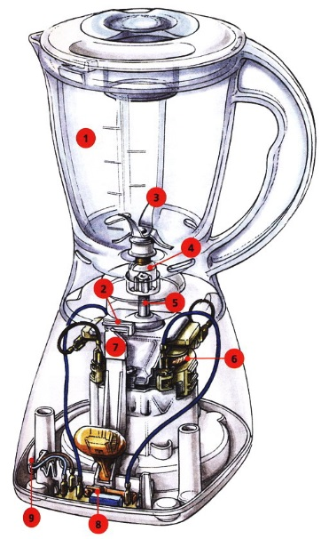

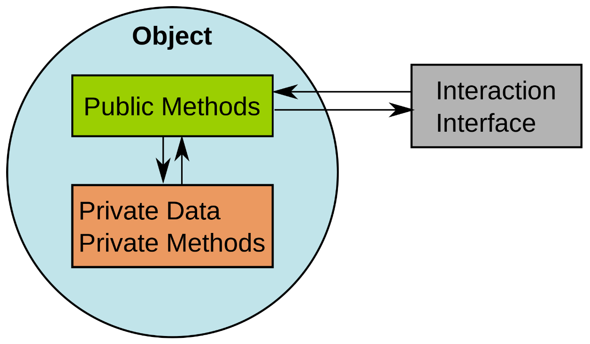
OOP principles. Encapsulation

Slide 20
EncapsulationAccess modifiers
public class Dog { public String name = "Scooby-doo"; protected boolean hasFur = true; boolean hasPaws = true; private int id; }

Slide 21
Encapsulation. Java Beans
A JavaBean is a design principle for encapsulating data in an object in Java.
private properties
public getter(get, is for primitive boolean)
public setter (set)
property name in getter/setter starts with uppercase

Slide 22
Encapsulation. Java Beans
class Animal { private boolean playing;
private Boolean hasPaws;
public String name;
public boolean isPlaying() { return playing; } public boolean getPlaying() { return playing; } public Boolean isHasPaws() { return hasPaws; }
…
…
public String name() { return name; } public void updateName(String n) { name = n; } public void setname(String n) { name = n; }
}

Slide 23
OOP principles. Abstraction
Abstract means a concept or an Idea which is not associated with any instance. Using abstract class/interface we express the intent of the class rather than the actual implementation. In a way, one class should not know the inner details of another in order to use it, just knowing the interfaces should be good enough.

Slide 24
OOP principles. Inheritance
Inheritances expresses “is-a” and/or “has-a” relationship between two objects. Using Inheritance, In derived classes we can reuse the code of existing super classes. In Java, concept of “is-a” is based on class inheritance (using extends) or interface implementation (using implements).

Slide 25
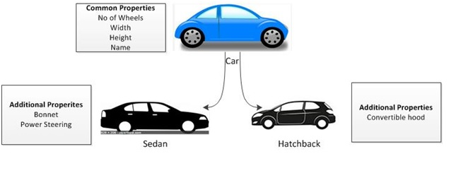
Inheritance (is-a)

Slide 26
Inheritance (is-a)
class Cow extends Animal { @Override public void feed() { } public void run(){ } }
abstract class Animal { String name; @Override public String toString() { return name; } abstract void feed(); }
class Bird extends Animal { @Override public void feed() { } public void fly(){ } }

Slide 27
Inheritance. Virtual methods invocation
class Cow extends Animal { public void feed() { addHay(); } private void addHay() { } } class Bird extends Animal { public void feed() { addSeed(); } private void addSeed() { } }
abstract class Animal { public abstract void feed(); }
public void feedAnimal(Animal animal) { animal.feed(); }

Slide 28
Composition (has-a)
Object composition is the idea of creating a class by connecting other classes as members using the has‐a principle.
Inheritance is the idea of creating a class that inherits all its reusable methods and objects from a parent class.
Both are used to create complex data models, each with its own advantages and disadvantages

Slide 29
Composition (has-a)
class Person { Job job; public Person() { this.job = new Job(); job.setSalary(1000L); } public long getSalary() { return job.getSalary(); } }
class Job { private long salary; public void setSalary(long salary) { this.salary = salary; } public long getSalary() { return salary; } }

Slide 30
OOP principles. Polymorphism
An object in Java may take on a variety of forms, in part depending on the reference used to access the object.
One name, many forms. Polymorphism manifests itself by having multiple methods all with the same name, but slightly different functionality.
There are 2 basic types of polymorphism.
Overriding, also called run-time (dynamic) polymorphism.
Overloading, which is referred to as compile-time (static) polymorphism.

Slide 31
OOP principles. Polymorphism
The type of the object determines which properties exist within the object in memory.
The type of the reference to the object determines which methods and variables are accessible to the Java program
Polymorphism is the ability of a single interface to support multiple underlying forms.
Polymorphism is the ability of a single interface to support multiple underlying forms.

Slide 32
OOP principles. Polymorphism
interface LivesInOcean { void makeSound(); } class Dolphin implements LivesInOcean { public void makeSound() { System.out.println("whistle"); } } class Whale implements LivesInOcean { public void makeSound() { System.out.println("sing"); } }
class Oceanographer { void checkSound(LivesInOcean animal) { animal.makeSound(); } void main(String[] args) { Oceanographer o = new Oceanographer(); o.checkSound(new Dolphin()); o.checkSound(new Whale()); } }

Slide 33
Homework
Extend previous homework implementation by next features:
implement Vigenère cipher encoder and decoder
implement Vigenère2x cipher encoder and decoder (regular Vigenère cipher that applies encoding/decoding twice)
implement Vigenère2x cipher using has-a relationship
implement Vigenère2x cipher using is-a relationship
implement Vigenère over Caesar cipher encoder (should encode phrase via Caesar and the result of encoding should encode one more time via Vigenère)
implement Vigenère over Caesar cipher decoder (should decode phrase via Vigenère and the result of encoding should encode one more time via Caesar)
All new ciphers should be:
added into Algorithms enum
created via factories
displayed in menu and history (implemented in Homework 2)

Slide 34
Links
Classes and Objects
Interfaces and Inheritance
Object-Oriented Programming Concepts
Vigenère cipher

Slide 35
Thanks!
Any Questions?
Or find us in Slack:
@Yaroslav Brahinets
@Vasya Rudas
@Oleksandr Kucher

